Slide 1
Prequalification and DBE
Ryan Griffith
Division of Construction

Slide 2
Prequalification
Prequalification provides a method by which the Department may review a contactors financial resources and technical expertise before allowing the contractor to bid.
Must be prequalified or they can not bid.

Slide 3
Considerations for Contractor’s prequalification
Equipment availability
Resumes of company personnel
Company experience
Evaluations from Construction

Slide 4
Details on Prequalification Certificate
Maximum Eligibility Amount(603 KAR 2:015)
Work Category of Prequalification

Slide 5
Unlimited Eligibility
Increased this in 2015
Minimum is $150 million
Only affects work as a prime contractor.

Slide 6
Disadvantaged Business Enterprise (DBE) items
DBE subcontractor must complete the work subcontracted to them.
Any second-tier subcontractor must be DBE’s and have CRSBD approval.
All work subcontracted to the DBE must be completed by the DBE.

Slide 7
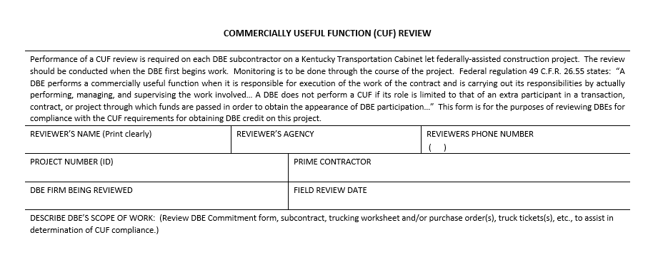
CUF Form

Slide 8
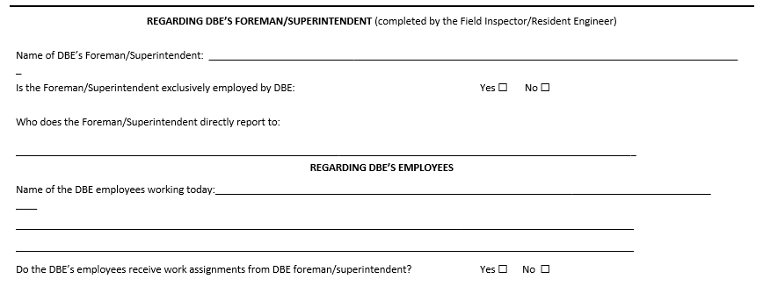
CUF Form

Slide 9
CUF Form

Slide 10
Questions???

